Slide 1
SESSION:17
Decimal Arithmetic operations
Peripheral Devices
Input Output Interface
Asynchronous Data Transfer
Asynchronous Data Transfer
Modes of Transfer

Slide 2
Decimal Arithmetic Operations
For arithmetic operations with decimal data are same as the algorithms for the binary data. In fact, except for a slight modification in the multiplication and division algorithms, we can use the same. Flowchart for both types of data provided that we interpret the micro-operation symbols properly. Decimal numbers in BCD are stored in computer registers in groups of four bits. Each 4-bit group represents a decimal digit and must be taken as a unit when performing decimal micro-operations.

Slide 3
Addition and Subtraction
The algorithm for addition and subtraction of binary signed-magnitude numbers can also be for decimal signed-magnitude numbers provided that we interpret the micro-operation symbols in the proper manner. Similarly, the algorithm for binary signed 2’s complement numbers can be used for decimal signed-10’s complement numbers. The binary data must use a binary adder and a complementer. The decimal data must use a decimal arithmetic unit capable of adding two BCD numbers and formatting the 9’s complement of the subtrahend

Slide 4
The parallel method is fast but needs a large number of adders. The digit-serial bit parallel method needs only one BCD adder, which is shared by all the digits. It is slower than the parallel method because of the time need to shift the digits. The all-serial method requires a minimum amount of equipment but is very slow.

Slide 5
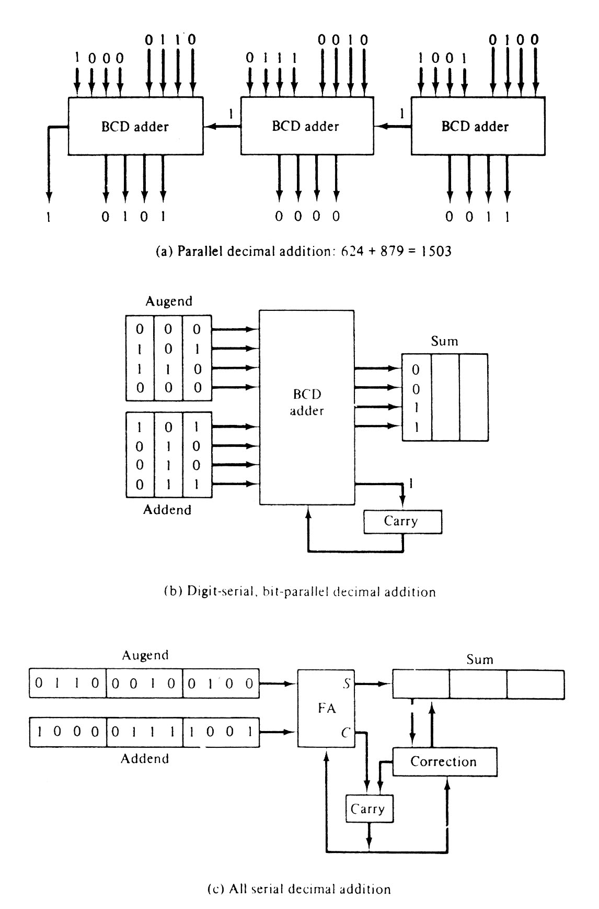

Slide 6
Multiplication
It is similar to binary except for the way the partial products are formed. A decimal multiplier has digits from 0 to 9, whereas a binary multiplier has only 0 and 1. In binary, the multiplicand is added to the partial product. This operation can be done by adding the multiplicand to the partial product a number of times equal to the value of the multiplier digit.

Slide 7
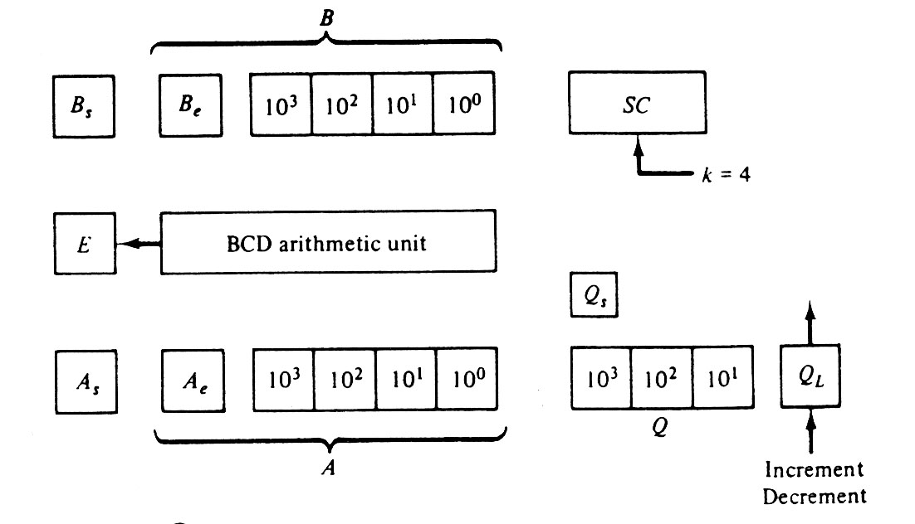

Slide 8
Division
Decimal division is same as that of binary division expect that the quotient digits may have any of the 10 values from 0 to 9. In the restoring division method, the divisor is subtracted from the dividend or partial remainder as many times as necessary until a negative remainder results. Adding the divisor then restores the correct remainder. The digit in the quotient reflects the number of subtractions up to but excluding the one that caused the negative difference.

Slide 9
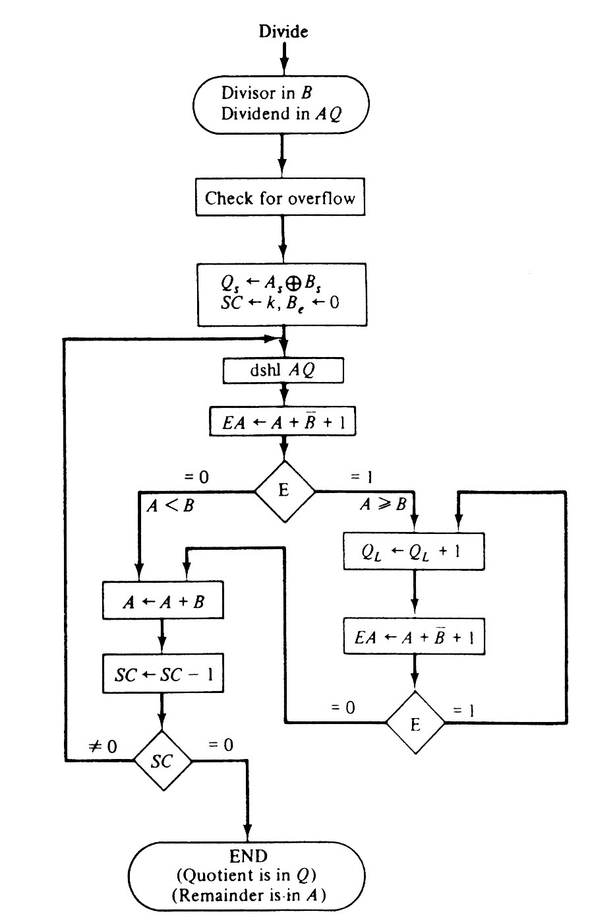

Slide 10
Peripheral Devices
A computer must have a system to get information from the outside world and must be able to the communicate results to the external world. Programs and data should be entered into computer memory for processing and results obtained from computations must be recorded or displayed for the user. The most familiar method of entering information into a computer is using a typewriter like keyboard that allows a person to enter alphanumeric information directly. Every time a key is depressed, the terminal sends a binary coded character to the computer.

Slide 11
Input-Output Interface
Input-output interface gives a method for transferring information between internal memory and I/O devices. Peripherals connected to a computer require special communication links for interfacing them with the central processing unit. The purpose of the communication link is to resolve the differences that exist between the central computer and each peripheral.
The major differences are:

Slide 12
Peripherals are electromechanical and electromagnetic devices and their manner of operation is different from the operation of the CPU and memory, which are electronic devices. Therefore a conversion of signal values may be required.
The data transfer rate of peripherals is usually slower than the transfer rate of the CPU.
Data codes and formats in peripherals differ from the word format in the CPU and memory.
The operating modes of peripherals are different from each other.

Slide 13
I/O Bus and Interface Modules
A communication link between the processor and several peripherals is represented the following figure 6.23. The I/O bus is made of data lines, address lines and control lines. The magnetic disk, printer and terminal are used in any general-purpose computer. The magnetic tape is used in computers for backup storage. Each peripheral device associated with it by interface unit. Each interface decodes the address and control received from the I/O bus, interprets them for the peripheral and provides signals for the peripheral controller.

Slide 14
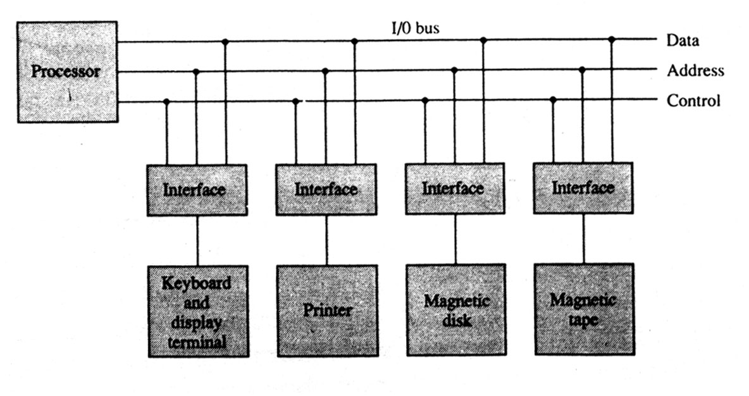
Processor

Slide 15
I/O versus Memory Bus
To communicate with I/O, the processor must communicate with the memory unit. The memory bus contains data, address and read/write control lines. There are three ways to use computer buses to communicate with memory and I/O:
1.Use two separate buses, one for the memory and the other for I/O.
2.Use one common bus for both memory and I/O but have separate control lines for each.
3.Use one common bus for memory and I/O with common control lines.

Slide 16
Isolated versus Memory-mapped I/O
One common bus may be employed to transfer information between memory or I/O and the CPU. Memory transfer and I/O transfer differs in that they use separate read and write lines. The CPU specifies whether the address on the address lines is for a memory word or for an interface register by enabling one of two possible read or write lines. The I/O read and I/O write control lines are enabled during an I/O transfer. The memory read and memory write control lines are enabled during a memory transfer. This configuration isolates all I/O interface addresses from the addresses assigned to memory and is referred to as the isolated I/O method for assigning addresses in a common bus.

Slide 17
Example of I/O interface
The input-output data to and from the device can be transferred into either port A or port B. The interface may operate with an output device or with an input device, or with a device that requires both input and output.
The distinction between data, control, or status information is determined from the particular interface register with which the CPU communicates.

Slide 18
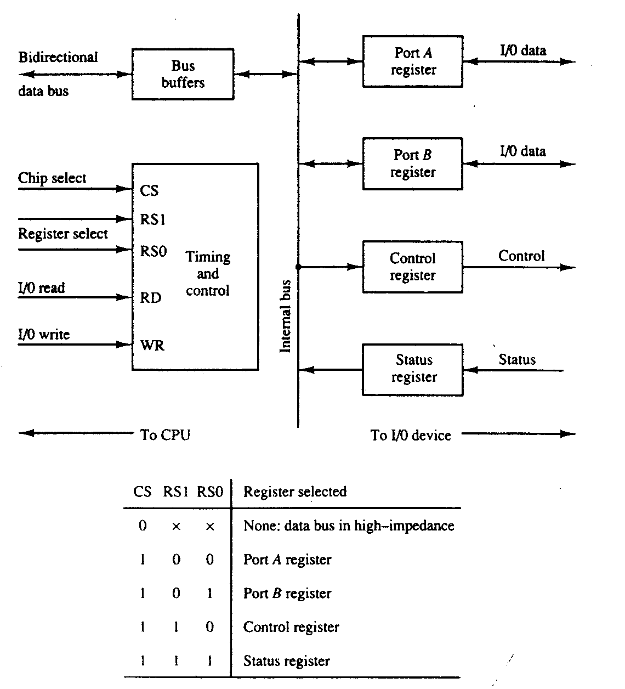

Slide 19
Asynchronous Data Transfer
The internal operations in a digital system are synchronized using a common pulse generator. Clock pulses are used by all registers within a unit and all data transfers among internal registers occur simultaneously during the occurrence of a clock pulse. Two units, such as a CPU and an I/O interface, are independent of each other.

Slide 20
The data bus is used to carry the binary information from source unit to the destination unit. Usually, the bus has multiple lines to transfer an entire byte or word. The strobe is a single line that informs the destination unit when a valid data word is available in the bus.

Slide 21
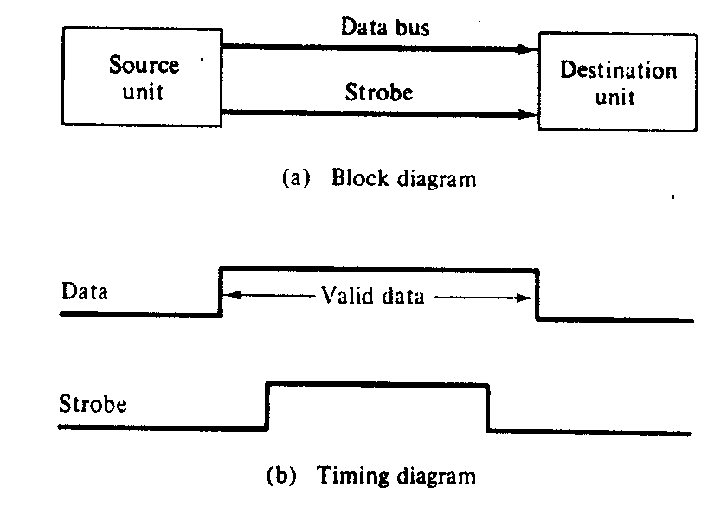

Slide 22
Asynchronous Serial Transfer
We can transfer the data between two units in parallel or serial. In parallel data transmission, each bit has its own path and the total message is transmitted at the same time. In serial data transmission, each bit is sent in sequence one at a time. This method requires the use of one pair of conductors or one conductor and a common ground. Parallel transmission is faster but requires many wires. So we use it for short distances and where speed is important.

Slide 23
Receiver can detect a transmitted character from knowledge of the transmission rules:
1.When a character is not being sent, the line is in the state 1.
2.The initiation of a character transmission is detected from the start bit, which is always 0.
3.The character bits always follow the start bit.
4.After the last bit of the character is transmitted, a stop bit is detected when the line returns to the I-state for at least one bit time.

Slide 24
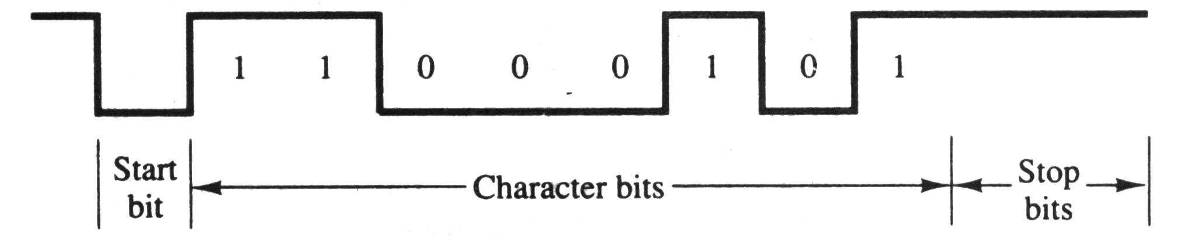

Slide 25
Mode of Transfer
Binary information received from an external device is usually stored in memory. Information transferred from the central computer into an external device initiates in the memory unit. The CPU only executes the I/O instructions and may accept the data temporarily, but the ultimate source or destination is the memory unit. Data transfer between the central computer and I/O devices may be handled in a variety of modes. Some modes use the CPU as an intermediate path; others transfer the data directly to and from the memory unit. Data transfer to and from peripherals may be done in either of three possible modes:

Slide 26
1. Programmed I/O
2.Interrupt-initiated I/O
3.Direct memory access (DMA)
The transfer of each byte needs three instructions:
1.Read the status register.
2.Check the status of the flag bit and branch to step I if not set or to step if set.
3.Read the data register.
A CPU register read each byte and then transferred to memory with a store instruction. I/O programming task is to transfer a block of words from an I/O device and store them in a memory buffer.

